Slide 1
A Specialized Capital Markets Assumptions Framework and Strategic Asset Allocation for US Life Insurers
Giga Nozadze
December 10, 2025

Slide 2
Life Insurers Require Specialized Risk/Return Framework due to their Nature and Inv. Horizon
My framework, which is based on slightly different measure of long-term risk and expected return suitable for life insurers, yields different portfolios for 6 US publicly listed insurers
Current allocations (transparent) are different from optimal weights (solid)
Brighthouse
Corebridge
Metlife
Principal
Prudential
Voya
1

Slide 3
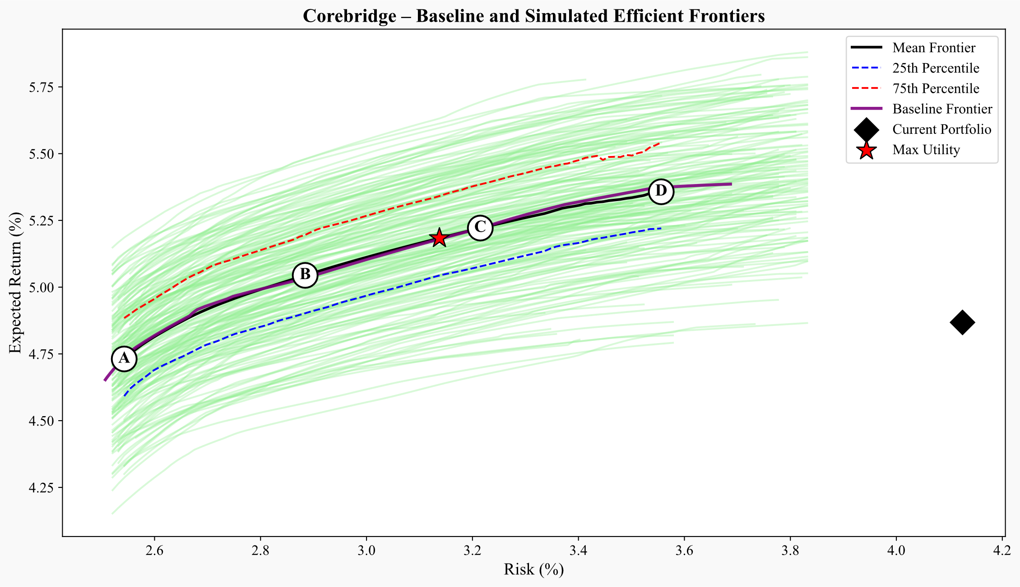
Corebridge’s Portfolio Is Safe and Capital-Efficient But Leaves Return on the Table
Corebridge’s current portfolio sits inside the efficient frontier, so higher return or lower risk is possible without extra capital.
Despite a disciplined setup with strong credit quality and low capital usage, the current mix underperforms both the mean and baseline efficient frontiers.
Note: the risk here is the Root Mean Squared Forecast Error (detailed in the next couple of slides), not the annual volatility measure
2

Slide 4
Optimized Allocation Enhances Surplus While Preserving Capital and Credit Quality
The utility-maximizing portfolio achieves higher Sharpe while also decreasing capital usage and improving portfolio credit rating.
The optimizer reallocates toward structured credit, residential mortgage whole loans, and private placements, top return-to-RBC assets, while trimming PE and RE due to weak capital efficiency.
Metric/Asset | Current | Port A | Port B | Port C | Port D | Max Utility
Expected Return (%) | 4.87 | 4.71 | 5 | 5.17 | 5.29 | 5.13
Risk (%) | 4.12 | 2.53 | 2.85 | 3.18 | 3.49 | 3.09
Sharpe Ratio | 0.21 | 0.28 | 0.35 | 0.37 | 0.37 | 0.36
Avg FI Credit Rating | A+ | AA- | AA- | A+ | A+ | AA-
FI Duration (years) | 6.18 | 6.43 | 6.7 | 6.81 | 7.09 | 6.76
Net Duration (years) | -0.69 | -0.44 | -0.17 | -0.06 | 0.22 | -0.11
Capital Use (%) | 1.72 | 0.81 | 1.3 | 1.74 | 2.1 | 1.62
US Treasuries, Short/Intermediate | 0.2 | 12 | 1 | 0.9 | 0.3 | 1
US Treasuries, Long | 0.3 | 0 | 0.1 | 1.3 | 5.2 | 0.8
US Taxable Munis | 1.9 | 0.4 | 0.1 | 0 | 0 | 0.1
Global ex-US Government, hedged | 1.8 | 0 | 0 | 0 | 0 | 0
US Public Corporates IG AAA | 2.8 | 15 | 11.3 | 8.8 | 2.4 | 9.8
US Public Corporates IG AA | 5.5 | 6.2 | 1.8 | 1.8 | 1 | 1.7
US Public Corporates IG A | 8.3 | 7.6 | 11.7 | 11.7 | 12.3 | 11.6
US Public Corporates IG BBB | 18.8 | 0 | 0 | 0 | 0 | 0
US Public Corporates, HY Intermediate | 1.3 | 0 | 0.3 | 0.8 | 0.8 | 0.7
US Public Corporates, HY Long | 1.6 | 0 | 0.8 | 3.3 | 4.1 | 2.8
Global ex-US Corporates, hedged | 0 | 10 | 5.8 | 1.3 | 0.2 | 2.2
Residential Mortgage-Backed Securities (RMBS) | 6.8 | 0.4 | 13 | 13.7 | 13.8 | 13.7
Commercial Mortgage-Backed Securities (CMBS) | 4.1 | 2.9 | 6.8 | 7.7 | 9.2 | 7.4
Asset-Backed Securities (ABS) | 12.8 | 0 | 0.2 | 0.6 | 1.2 | 0.4
Corporate IG Private Placement A | 4.5 | 15 | 15 | 15 | 15 | 15
Corporate IG Private Placement BBB | 5.1 | 15 | 15 | 15 | 15 | 15
Corporate HY Private (Leveraged Loans) | 0.8 | 0 | 0.1 | 0.1 | 0.1 | 0.1
Residential Mortgage Whole Loans | 5.5 | 15 | 15 | 14.8 | 14.5 | 14.8
Commercial Mortgage Whole Loans | 15.6 | 0 | 0 | 0.1 | 1 | 0.1
Private Equity | 2.5 | 0.6 | 2 | 3 | 4.1 | 2.7
Real Estate (via partnerships, equity) | 0 | 0 | 0 | 0 | 0 | 0
3

Slide 5
Liability Term-Structure Modeling
Defined Contribution & Group Benefits: short-dated obligations from employer retirement plans and group insurance programs. Highly liquid and concentrated in the first few years
Stable-Value and Funding-Agreement Contracts: medium-term obligations supporting stable-value funds and funding-agreement notes. Extend further than group benefits but with limited long-duration exposure
Variable Annuity Accumulation & Fixed Deferred Annuities: medium-dated liabilities from the accumulation phase of annuity contracts. Cash flows typically peak in the 3-12 year window due to surrender and annuitization behavior
Lifetime Payout Annuities and Pension-Risk-Transfer Contracts: long-dated income payments that extend 20-30 years or more. Significant long-duration exposure requiring assets with matching interest-rate sensitivity
Universal Life and Lifetime Protection Products: very long-horizon liabilities with guarantees and mortality/lapse dynamics. Thick tail beyond 20 years and strong sensitivity to long-term rates.
Company | DC & Group | Stable-Value | AA / Deferred | Lifetime Payout / PRT | Universal Life / Protection | Avg Duration | Convexity | Share 1Y | Share 5Y
Brighthouse | 0.10 | 0.00 | 0.35 | 0.25 | 0.30 | 9.53 | 53.07 | 0.05 | 0.28
Corebridge | 0.25 | 0.15 | 0.30 | 0.15 | 0.15 | 6.87 | 40.92 | 0.10 | 0.47
MetLife | 0.20 | 0.00 | 0.15 | 0.40 | 0.25 | 9.51 | 57.39 | 0.06 | 0.29
Principal | 0.50 | 0.20 | 0.20 | 0.05 | 0.05 | 4.89 | 24.42 | 0.16 | 0.64
Prudential | 0.10 | 0.00 | 0.15 | 0.45 | 0.30 | 10.70 | 58.67 | 0.04 | 0.22
Voya | 0.50 | 0.25 | 0.15 | 0.05 | 0.05 | 4.75 | 23.71 | 0.16 | 0.66
4

Slide 6
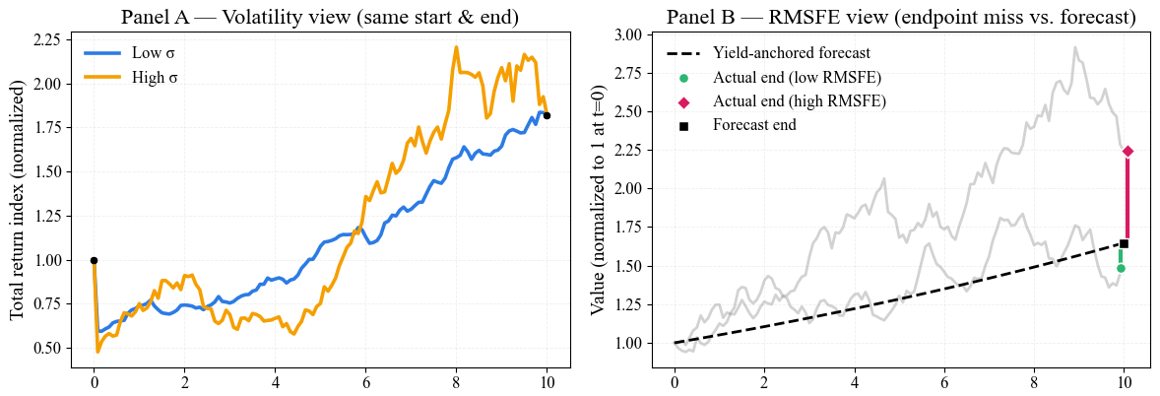
Forecast Error Is the Right Risk Metric for Long-Term, Hold-to-Maturity Investors
For life insurers, the thing that drives results over a ten-year horizon is the cash yield collected, adjusted for credit losses, while day to day price swings matter (or should matter) far less.
Traditional volatility (standard deviation of 1-year returns) exaggerates uncertainty for insurers, who reinvest and hold to maturity.
Root Mean Squared Forecast Error (RMSFE, detailed later) captures the true risk: how far realized return deviates from yield-based forecast (bond’s starting yield) over 10 years.
5

Slide 7
Mean Reversion Reduces Long-Horizon Risk, Especially in High Yield
Bond returns are not independent year to year, so serial correlation and particularly mean reversion pulls weak periods back toward trend, making long-term returns more stable than √t-scaled short-term volatility implies.
This time diversification effect is strongest in high yield, where credit spreads overshoot and recover post-stress, which is why 15Y-CAGR Vol*√15 is significantly lower than 1Y vol. If there was no serial correlation and mean reversion, those two numbers would coincide because of square-root-of-time rule in adding volatilities over time.
Time diversification effect is most pronounced in HY securities, with standard deviation of longer
6

Slide 8
Starting Yield Contains Useful Information about Long-Term Bond Returns Across Sectors
Across bond types, the starting yield explains most of the 10-year return, with R² values above 0.85 and slopes near 1.
This reinforces the case for using starting yield minus expected credit loss as the central input for return forecasts, especially for hold-to-maturity insurers.
Starting yield is a good indicators of actual returns
7

Slide 9
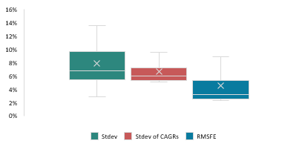

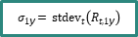

Volatility Is Not Long-Term Risk, and RMSFE Captures What Actually Matters
RMSFE measures forecast error around the yield-based return anchor, bundling reinvestment and credit-loss risk, the core uncertainties insurers face.
Due to serial correlation and mean reversion in bond returns, the long-term volatility (red) is lower than short-term volatility (green) scaled by square-root-of-time, which is further reduced when the information contained in starting yields enters the picture.
Taking into account the mean reversion and starting yields results in considerably lower risk measures
$$σ_{\text{ann}}\left(10\right) = \sqrt{10} σ_{CAGR}\left(10\right)$$
$$σ_{1\text{y}}= {stdev}_{t}\left(R_{t,1\text{y}}\right)$$
$${RMSFE}_{\text{ann}}\left(10\right) = \sqrt{ {avg}_{t}[ε(t)]} × \sqrt{10}$$
8

Slide 10
Private Credit
Index | Source | Construction | Motivation
Residential Mortgage Loans | Bloomberg | Direct private mortgage loan index | Captures residential private lending premiums
Commercial Mortgage Loans | Bloomberg | Direct commercial mortgage loan index | Captures spread & underwriting risk of CRE debt
Leveraged Loans | Bloomberg | High-yield, floating-rate, institutional leveraged loan market | Proxy for private unitranche/first-lien lending
Private Credit IG A | Synthetic | 6M MA of Public IG A + 30 bps | Reflects private IG underwriting + illiquidity
Private Credit IG BBB | Synthetic | 6M MA of Public IG BBB + 60 bps | Matches BBB private credit spreads & liquidity premium
9

Slide 11
Private Equity Delivers Equity Beta and Growth, But Net Alpha is Illusory
Private equity behaves like a leveraged small-cap equity strategy, with higher equity beta, modest real growth advantage, and limited evidence of persistent alpha after fees.
Illiquidity premia are often overstated: investors tolerate reduced transparency and volatility smoothing in exchange for headline stability, not economic compensation.
Income Yield | Real Growth Rate | Real Unlevered Return | Debt to Equity | Real Cost of Debt | Real levered Return | Multiple Expansion | Gross Real ER | Fees | Net Expected Real Return | Expected Inflation | Net Expected Return
3.6% | + 3.0% | = 6.6% | 52.0% | 3.1% | 8.4% | + 3.0% | = 11.4% | -4.0% | = 7.4% | + 2.3% | = 9.7%
For real estate, unlevered expected returns are anchored in net operating income (NOI) minus recurring capital expenditures, yielding a real free cashflow return of ~3.1%.
Real growth is assumed to be negligible over long horizons, resulting in a nominal unlevered return of ~5.4% after adding expected inflation.
NOI yield | CapEx (~NOI/3) | Cashflow yield | Real growth | Unlevered real ER | Expected inflation | Unlevered nominal ER
4.7% | - 1.6% | = 3.1% | + 0.0% | = 3.1% | + 2.3% | = 5.4%
10

Slide 12
Every Asset Modeled with Yield Anchors, Capital Charges, and Horizon-Aligned Risk
 | Asset | Schdl. | Rating | NAIC | Capital Charge | Mat. (year) | Dur. (year) | Starting Yield | ECL | Expected Return | ER (Cap-Adjusted) | Short-term Volatility | Long-term Uncertainty | Weighted-Avg Risk
Government | US Treasuries, Short/Intermediate | D-1 | AAA | 1A | 0.00% | 4.0 | 3.7 | 3.83% | 0.00% | 3.83% | 3.83% | 6.01% | 2.93% | 3.86%
 | US Treasuries, Long | D-1 | AAA | 1A | 0.00% | 22.1 | 13.8 | 4.80% | 0.00% | 4.80% | 4.80% | 13.57% | 6.36% | 8.52%
 | US Taxable Munis | D-1 | AA | 1C | 0.00% | 13.3 | 10.6 | 3.96% | 0.10% | 3.86% | 3.86% | 8.21% | 2.41% | 4.15%
 | Global ex-US Government, hedged | D-1 | AA | 1C | 0.42% | 9.7 | 8.3 | 3.07% | 0.10% | 2.97% | 2.80% | 3.99% | 4.24% | 4.17%
Public Corporates | US Public Corporates IG AAA | D-1 | AAA | 1A | 0.16% | 5.4 | 5.0 | 4.23% | 0.00% | 4.23% | 4.16% | 4.45% | 2.29% | 2.94%
 | US Public Corporates IG AA | D-1 | AA | 1C | 0.42% | 7.8 | 6.8 | 4.36% | 0.10% | 4.26% | 4.09% | 5.48% | 2.45% | 3.36%
 | US Public Corporates IG A | D-1 | A | 1F | 0.82% | 10.3 | 8.3 | 4.87% | 0.07% | 4.80% | 4.48% | 6.27% | 2.82% | 3.85%
 | US Public Corporates IG BBB | D-1 | BBB | 2B | 1.52% | 10.5 | 8.2 | 5.21% | 0.49% | 4.72% | 4.11% | 7.23% | 3.20% | 4.41%
 | US Public Corporates, HY Intermediate | D-1 | BB– | 3C | 6.02% | 4.5 | 3.9 | 7.04% | 0.67% | 6.37% | 3.96% | 12.46% | 12.80% | 12.70%
 | US Public Corporates, HY Long | D-1 | BB– | 3C | 6.02% | 16.3 | 9.5 | 7.87% | 0.67% | 7.20% | 4.79% | 18.04% | 8.94% | 11.67%
 | Global ex-US Corporates, hedged | D-1 | A | 1F | 0.82% | 7.0 | 6.2 | 3.92% | 0.07% | 3.85% | 3.52% | 5.99% | 1.12% | 2.58%
Structured | Residential Mortgage-Backed Securities | D-1 | AA | 1C | 0.00% | 7.8 | 6.7 | 4.93% | 0.10% | 4.83% | 4.83% | 8.15% | 3.09% | 4.61%
 | Commercial Mortgage-Backed Securities | D-1 | AA | 1C | 0.00% | 4.4 | 4.1 | 4.69% | 0.10% | 4.59% | 4.59% | 7.74% | 3.69% | 4.90%
 | Asset-Backed Securities | D-1 | AA | 1C | 0.42% | 3.6 | 3.3 | 4.41% | 0.10% | 4.31% | 4.14% | 5.82% | 5.49% | 5.59%
Private Credit | Corporate IG Private Placement A | D-1 | A | 1F | 0.82% | 10.3 | 8.1 | 5.52% | 0.07% | 5.45% | 5.13% | 5.34% | 2.78% | 3.55%
 | Corporate IG Private Placement BBB | D-1 | BBB | 2B | 1.52% | 10.5 | 8.0 | 6.14% | 0.49% | 5.65% | 5.05% | 5.70% | 3.20% | 3.95%
 | Corporate HY Private (Leveraged Loans) | D-1 | B+ | 4A | 7.39% | 4.7 | 3.9 | 7.99% | 2.42% | 5.57% | 2.62% | 14.43% | 8.94% | 10.58%
 | Residential Mortgage Whole Loans | B | AA | 1C | 0.68% | 7.7 | 6.4 | 4.90% | 0.10% | 4.80% | 4.52% | 2.86% | 3.09% | 3.02%
 | Commercial Mortgage Whole Loans | B | AAA | 1A | 0.90% | 4.4 | 4.1 | 4.76% | 0.00% | 4.76% | 4.40% | 13.15% | 6.62% | 8.58%
Illiq. | Private Equity | BA | - | - | 30.00% | - | - | 9.68% |  | 9.68% | 6.68% | - | - | 25.27%
 | Real Estate (via partnerships, equity) | BA | - | - | 30.00% | - | - | 5.40% |  | 5.40% | 2.40% | - | - | 17.5%
11

Slide 13
Surplus-Aware Optimizer Simulates Liability-Aligned, Capital-Efficient Frontiers
Element | Summary
Objective | Maximize expected return net of surplus volatility and capital charge.
Key Formula | max (μᵀw − λ(wᵀΣw) − ϕ(cᵀw))
Risk Aversion (λ) | Controls penalty for surplus volatility.
Capital Penalty (ϕ) | Penalizes capital-intensive allocations using NAIC RBC charges.
Robustness | Monte Carlo resampling across 100 capital market scenarios.
Portfolio Constraints | Asset weights: 0%–12%, Credit quality ≥ A+, BBB ≤ 15%, below IG ≤ 5%
Strategic Asset Limits | Strategic Assets ≤ 35%, Private Credit & Mortgage Loans ≤ 60%, RE ≤ 5%,
Liability Matching | Duration within ±1.5Y of liabilities, optional key-rate duration (KRD) matching active
Framework reflects realistic insurer constraints and surplus-driven logic, not actual internal allocation tools
12

Slide 14
Simulating Surplus Under Macro Risk Reveals RMSFE Portfolios Are Superior
A multi-factor model links asset returns to macro variables (rates, curve, credit spreads, equities), estimating both regime-specific sensitivities and idiosyncratic risk.
Joint simulations of assets and liabilities over 10,000 macro scenarios show that portfolios built with RMSFE risk outperformed those built with volatility risk, especially in terms of long-term surplus stability.
RMSFE portfolios deliver higher median surplus growth, lower shortfall risk, and greater capital efficiency, thanks to better alignment with long-horizon liability dynamics and macro risk structure.
Company | Δ Surplus CAGR (RMSFE–VOL) | Δ P(Surplus<0) | Δ Surplus/RBC
Brighthouse | +0.42% | −7.79% | +0.03
Corebridge | +0.14% | −0.63% | +0.11
MetLife | +0.30% | −6.32% | +0.07
Principal | +0.16% | −2.03% | +0.08
Prudential | +0.10% | −2.26% | +0.02
Voya | +0.15% | −2.14% | +0.07
13

Slide 15
Appendix
All the materials and sources used are located on this drive, and this GitHub repository contains all the files for the project, including the paper (longer, more detailed) version of this analysis.
14

Slide 16
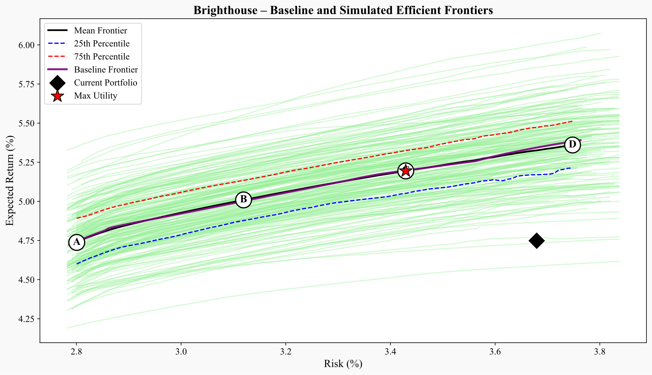
Brighthouse’s Long-Dated Liabilities Benefit from Duration Extension and Higher Capital Efficiency
The current portfolio is stable but sits inside the efficient frontier: expected return rises from 4.75% to more than 5.20% with risk reduced by 20 to 50 bps along the optimized frontier, improving Sharpe from 0.20 to 0.35 while maintaining strong credit quality.
Efficiency gains come from eliminating BBB corporates and commercial mortgage loans and reallocating to private placements, RMBS, and long Treasuries, which strengthen duration alignment and cut capital use from 1.92% to as low as 0.72%.
Metric/Asset | Current | Max Utility
Expected Return (%) | 4.75 | 5.21
Risk (%) | 3.68 | 3.48
Sharpe Ratio | 0.2 | 0.35
Avg FI Credit Rating | AA- | A+
FI Duration (years) | 6.2 | 8.03
Net Duration (years) | -3.33 | -1.5
Capital Use (%) | 1.92 | 1.66
US Treasuries, Short/Intermediate | 3.7 | 0
US Treasuries, Long | 2.6 | 11.1
US Taxable Munis | 3.3 | 3
Global ex-US Government, hedged | 0.9 | 0
US Public Corporates IG AAA | 3.2 | 0.9
US Public Corporates IG AA | 6.4 | 1
US Public Corporates IG A | 9.6 | 14.4
US Public Corporates IG BBB | 9.2 | 0
US Public Corporates, HY Intermediate | 0.5 | 0.3
US Public Corporates, HY Long | 0.3 | 4.3
Global ex-US Corporates, hedged | 11.1 | 1.3
Residential Mortgage-Backed Securities (RMBS) | 7.4 | 13.2
Commercial Mortgage-Backed Securities (CMBS) | 5.8 | 2.7
Asset-Backed Securities (ABS) | 5.4 | 0.2
Corporate IG Private Placement A | 4.1 | 15
Corporate IG Private Placement BBB | 2 | 15
Corporate HY Private (Leveraged Loans) | 0.2 | 0
Residential Mortgage Whole Loans | 6.7 | 14.9
Commercial Mortgage Whole Loans | 13.4 | 0.1
Private Equity | 3.6 | 2.7
Real Estate (via partnerships, equity) | 0.6 | 0
16

Slide 17
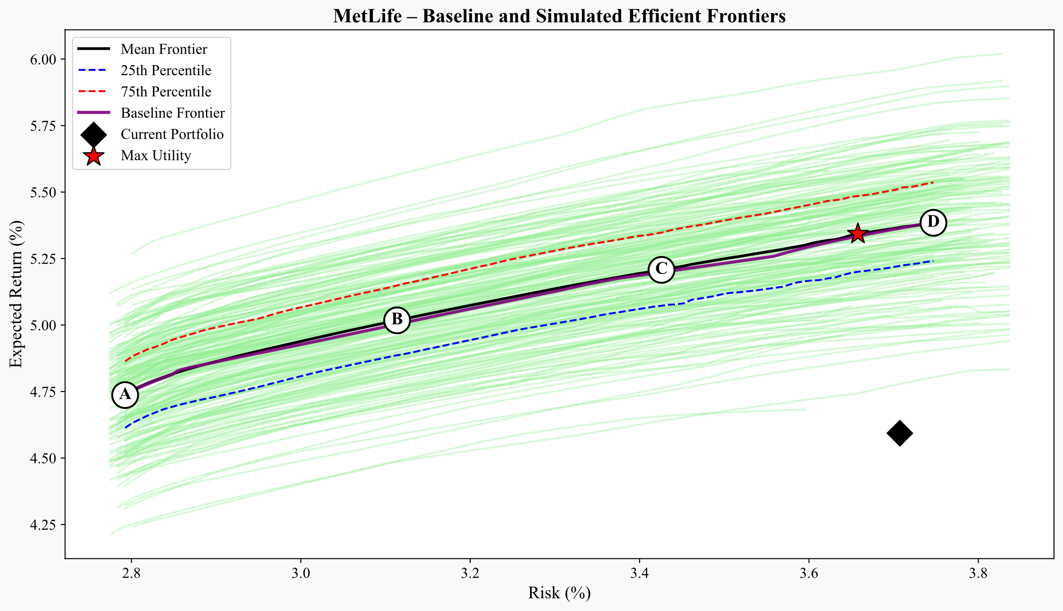
MetLife’s Long-Dated Liabilities Gain from Reducing Global Sovereigns
The current portfolio sits inside the frontier, with a low Sharpe of 0.16; optimized portfolios raise expected return to 5.29% and reduce risk by more than 50 bps, lifting Sharpe to 0.36 while preserving MetLife’s high credit quality.
Efficiency gains come from reducing global sovereigns and commercial mortgage loans and reallocating toward private placements, RMBS, CMBS, and long Treasuries, which improve duration alignment and cut capital use from 2.63% to below 1%.
Metric/Asset | Current | Max Utility
Expected Return (%) | 4.59 | 5.29
Risk (%) | 3.71 | 3.64
Sharpe Ratio | 0.16 | 0.36
Avg FI Credit Rating | AA- | A+
FI Duration (years) | 6.15 | 8.02
Net Duration (years) | -3.36 | -1.49
Capital Use (%) | 2.63 | 1.93
US Treasuries, Short/Intermediate | 4 | 0
US Treasuries, Long | 3.9 | 13.2
US Taxable Munis | 2.4 | 0.9
Global ex-US Government, hedged | 10.3 | 0
US Public Corporates IG AAA | 1.6 | 0.3
US Public Corporates IG AA | 3.2 | 0.6
US Public Corporates IG A | 4.8 | 14
US Public Corporates IG BBB | 3.8 | 0
US Public Corporates, HY Intermediate | 0.3 | 0.4
US Public Corporates, HY Long | 0.3 | 4.6
Global ex-US Corporates, hedged | 14.3 | 0.2
Residential Mortgage-Backed Securities (RMBS) | 9.9 | 13.2
Commercial Mortgage-Backed Securities (CMBS) | 2.3 | 4
Asset-Backed Securities (ABS) | 5.1 | 0.2
Corporate IG Private Placement A | 4 | 15
Corporate IG Private Placement BBB | 1.6 | 15
Corporate HY Private (Leveraged Loans) | 0.2 | 0
Residential Mortgage Whole Loans | 7 | 14.4
Commercial Mortgage Whole Loans | 14 | 0.4
Private Equity | 3.4 | 3.5
Real Estate (via partnerships, equity) | 3.4 | 0
17

Slide 18
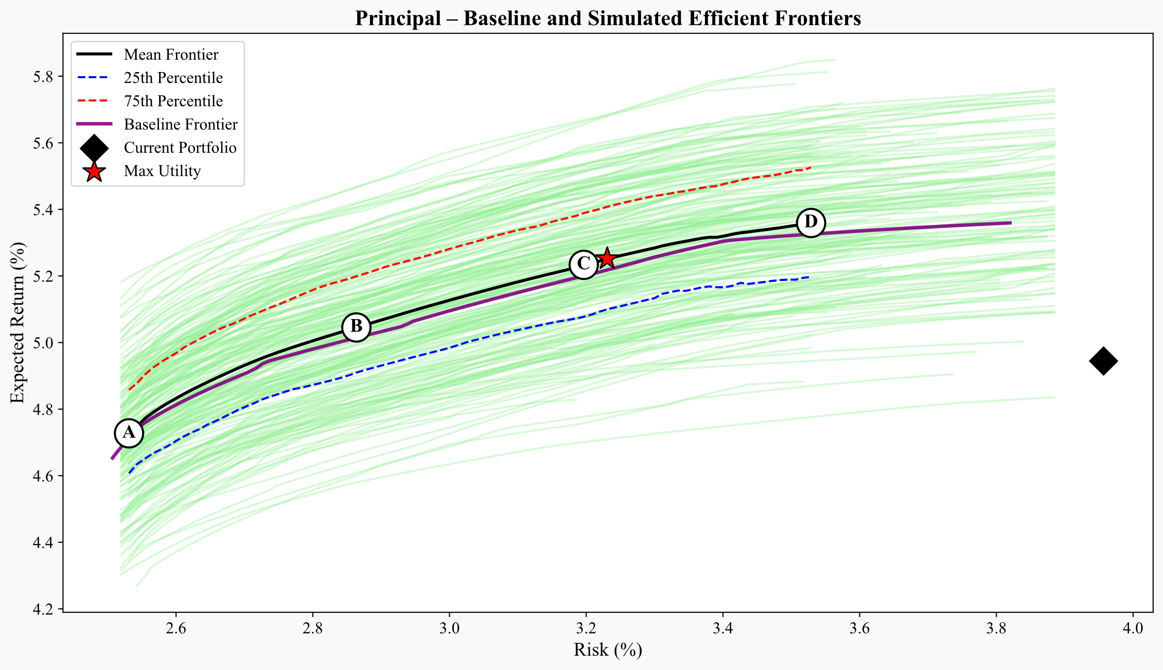
Principal Nears Its Efficient Frontier, but Targeted Reallocation Enhances Surplus Stability
The current portfolio earns a solid 4.94 percent return but carries nearly one full percentage point more surplus volatility than optimized portfolios that achieve similar returns with risk near 3.12 percent and a Sharpe ratio of 0.36.
Efficiency gains come from replacing BBB public corporates and commercial mortgage whole loans with private placements, RMBS, CMBS, and mortgage whole loans, reducing capital use from 2.42 percent to below 1 percent while maintaining duration alignment and high credit quality.
Metric/Asset | Current | Max Utility
Expected Return (%) | 4.94 | 5.13
Risk (%) | 3.96 | 3.12
Sharpe Ratio | 0.24 | 0.36
Avg FI Credit Rating | A+ | AA-
FI Duration (years) | 6.49 | 6.38
Net Duration (years) | 1.6 | 1.49
Capital Use (%) | 2.42 | 1.79
US Treasuries, Short/Intermediate | 0.7 | 2
US Treasuries, Long | 0.8 | 0.2
US Taxable Munis | 6 | 0
Global ex-US Government, hedged | 0.5 | 0
US Public Corporates IG AAA | 3 | 11.4
US Public Corporates IG AA | 4.5 | 0.9
US Public Corporates IG A | 9 | 6.7
US Public Corporates IG BBB | 19.4 | 0
US Public Corporates, HY Intermediate | 0.8 | 1
US Public Corporates, HY Long | 1 | 2.2
Global ex-US Corporates, hedged | 0 | 1.7
Residential Mortgage-Backed Securities (RMBS) | 3.6 | 13.4
Commercial Mortgage-Backed Securities (CMBS) | 5 | 9.9
Asset-Backed Securities (ABS) | 6.6 | 1.8
Corporate IG Private Placement A | 6.3 | 15
Corporate IG Private Placement BBB | 7.4 | 15
Corporate HY Private (Leveraged Loans) | 0.7 | 0.2
Residential Mortgage Whole Loans | 6.6 | 14.8
Commercial Mortgage Whole Loans | 13.2 | 0.2
Private Equity | 3.4 | 3.4
Real Estate (via partnerships, equity) | 1.7 | 0
18

Slide 19
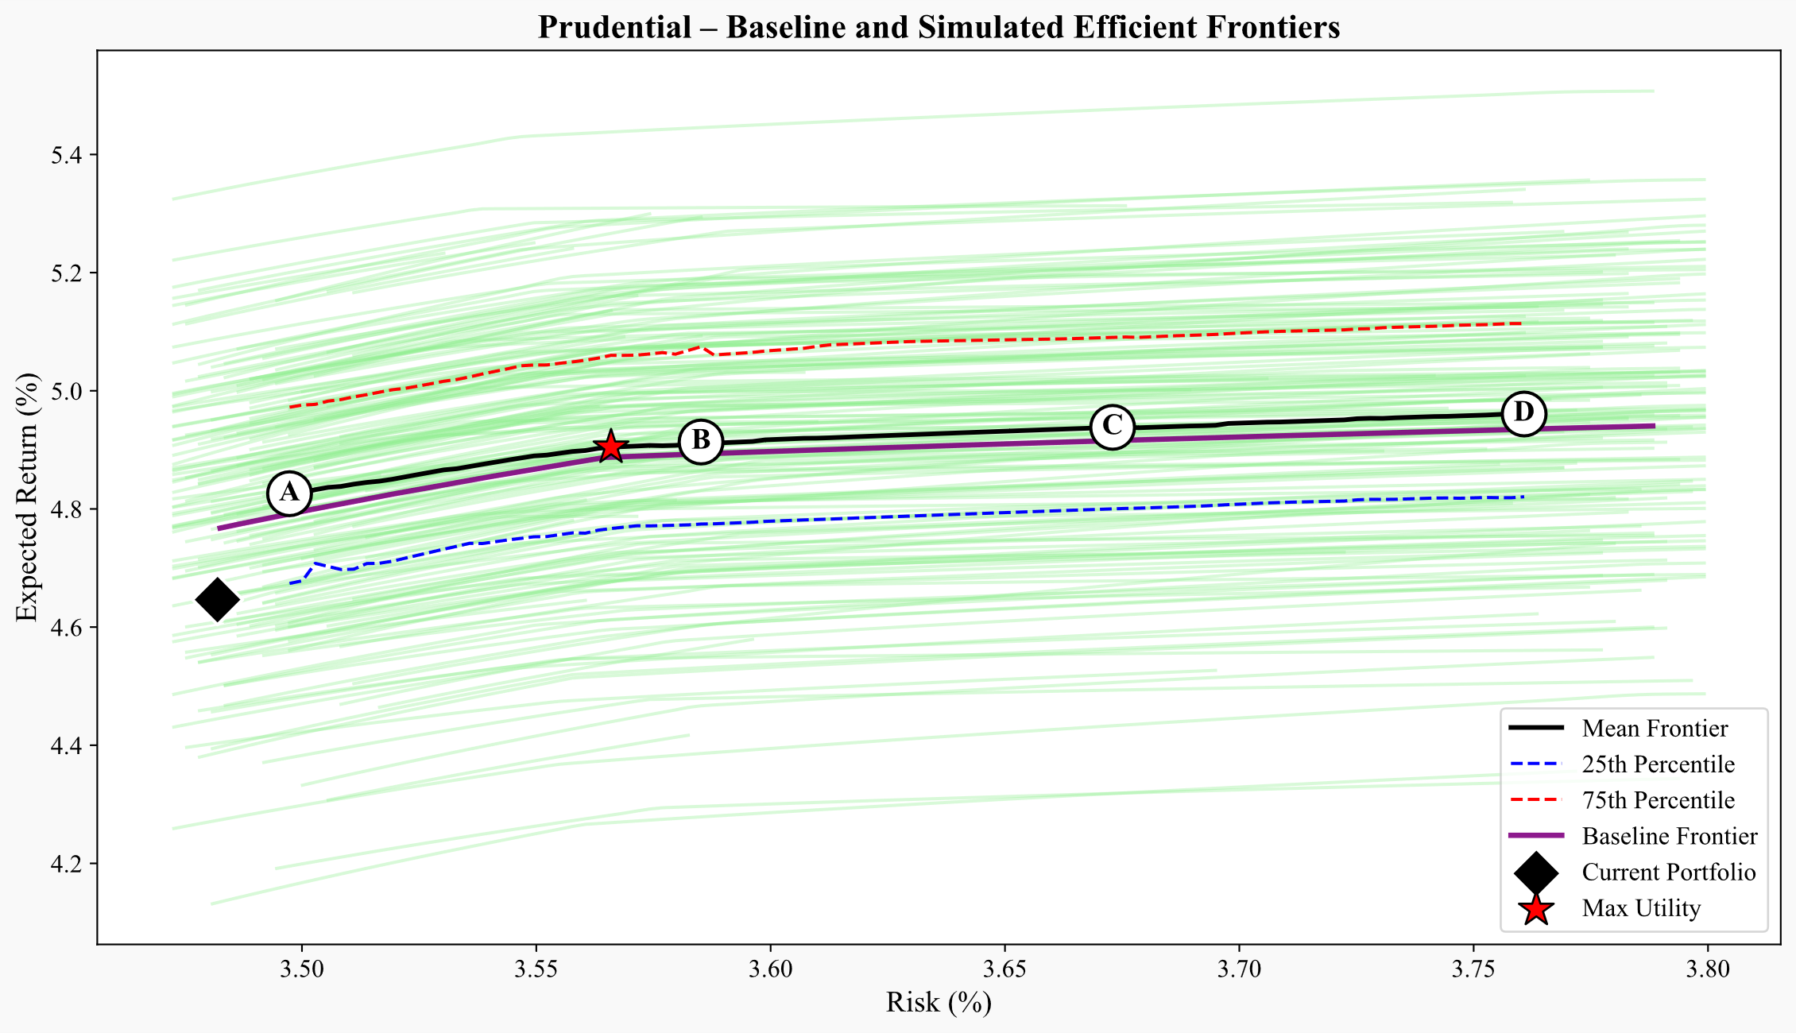
Prudential’s Book Is Close to Efficient, but Global Sovereigns and Commercial Loans Hold Back Capital Efficiency
The current portfolio delivers a 4.65 percent return at 3.48 percent risk, but optimized portfolios raise expected return to 4.88 percent with similar risk or reduce risk by 20 to 40 bps at comparable returns, improving the Sharpe ratio from 0.19 to 0.25.
Efficiency gains come from trimming global sovereigns and eliminating commercial mortgage loans and BBB public corporates, reallocating toward private placements, RMBS, and long Treasuries, which raise duration alignment and keep capital use below 1 percent.
Metric/Asset | Current | Max Utility
Expected Return (%) | 4.65 | 4.88
Risk (%) | 3.48 | 3.56
Sharpe Ratio | 0.19 | 0.25
Avg FI Credit Rating | AA- | A+
FI Duration (years) | 6.84 | 9.2
Net Duration (years) | -3.86 | -1.5
Capital Use (%) | 1.66 | 0.88
US Treasuries, Short/Intermediate | 2.5 | 0
US Treasuries, Long | 2.6 | 15
US Taxable Munis | 1.4 | 15
Global ex-US Government, hedged | 14.6 | 6.6
US Public Corporates IG AAA | 2.7 | 0
US Public Corporates IG AA | 5.4 | 0
US Public Corporates IG A | 8.2 | 15
US Public Corporates IG BBB | 7.7 | 0
US Public Corporates, HY Intermediate | 0.8 | 0
US Public Corporates, HY Long | 0.9 | 4.8
Global ex-US Corporates, hedged | 6 | 0
Residential Mortgage-Backed Securities (RMBS) | 1 | 0.5
Commercial Mortgage-Backed Securities (CMBS) | 2.4 | 0
Asset-Backed Securities (ABS) | 4.6 | 0
Corporate IG Private Placement A | 13.4 | 15
Corporate IG Private Placement BBB | 6.3 | 15
Corporate HY Private (Leveraged Loans) | 1.4 | 0
Residential Mortgage Whole Loans | 5.2 | 13.1
Commercial Mortgage Whole Loans | 10.4 | 0
Private Equity | 2.1 | 0
Real Estate (via partnerships, equity) | 0.5 | 0
19

Slide 20
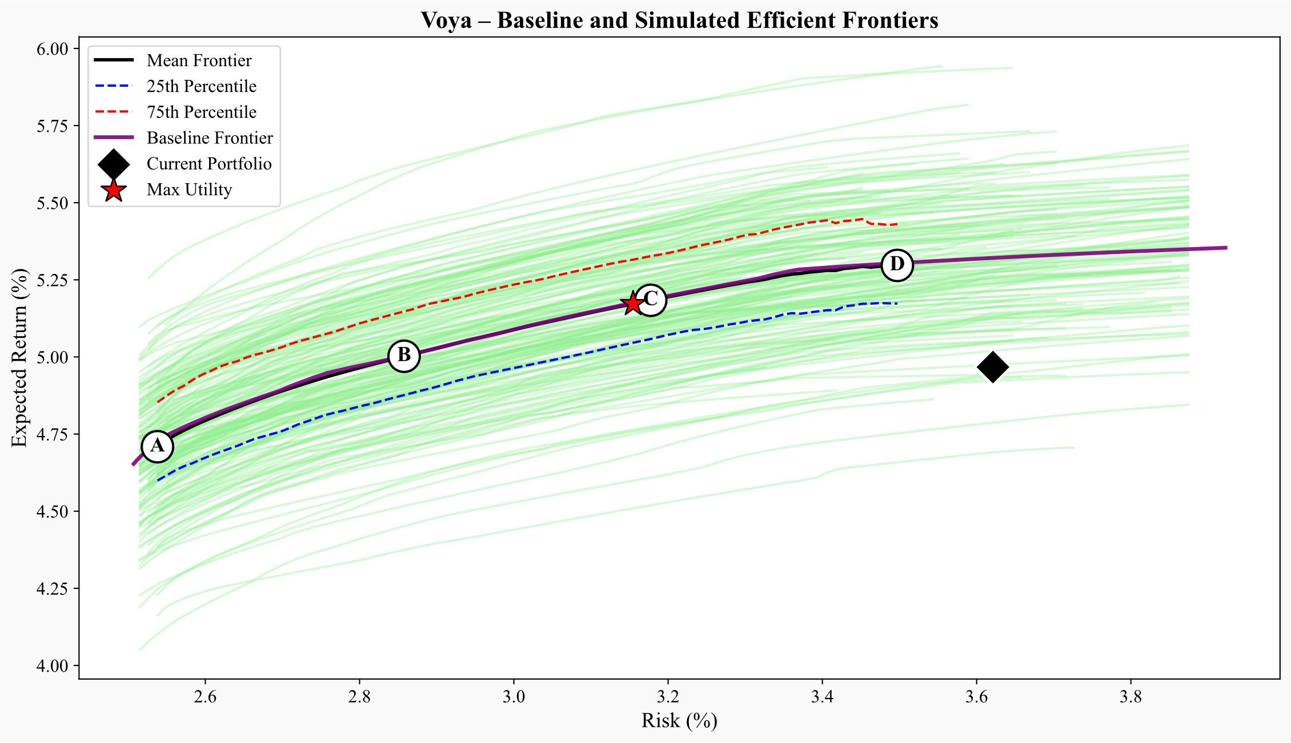
Voya’s Shorter Liabilities Allow Capital-Efficient Gains Through Reallocation to Structured and Private Credit
The current portfolio delivers a solid 4.97 percent return but sits inside the frontier, with optimized portfolios achieving similar returns at risk near 3.16 percent and a Sharpe ratio rising from 0.27 to 0.36.
Efficiency gains come from removing BBB corporates and reducing commercial mortgage loans and global exposures while increasing private placements, RMBS, CMBS, and mortgage whole loans, which improves capital efficiency and enhances surplus stability without sacrificing return.
Metric/Asset | Current | Max Utility
Expected Return (%) | 4.97 | 5.15
Risk (%) | 3.62 | 3.16
Sharpe Ratio | 0.27 | 0.36
Avg FI Credit Rating | AA- | AA-
FI Duration (years) | 6.2 | 6.25
Net Duration (years) | 1.45 | 1.5
Capital Use (%) | 2.16 | 1.93
US Treasuries, Short/Intermediate | 0.7 | 3.2
US Treasuries, Long | 0.9 | 0.1
US Taxable Munis | 1.4 | 0
Global ex-US Government, hedged | 3.4 | 0
US Public Corporates IG AAA | 1.4 | 11.4
US Public Corporates IG AA | 4 | 1.3
US Public Corporates IG A | 5.1 | 4.3
US Public Corporates IG BBB | 8.3 | 0
US Public Corporates, HY Intermediate | 0.5 | 1.2
US Public Corporates, HY Long | 0.6 | 2.3
Global ex-US Corporates, hedged | 6.8 | 1.5
Residential Mortgage-Backed Securities (RMBS) | 9.9 | 13
Commercial Mortgage-Backed Securities (CMBS) | 8.1 | 11.1
Asset-Backed Securities (ABS) | 7.9 | 1.7
Corporate IG Private Placement A | 11.6 | 15
Corporate IG Private Placement BBB | 9.2 | 15
Corporate HY Private (Leveraged Loans) | 1.2 | 0.2
Residential Mortgage Whole Loans | 4.9 | 14.6
Commercial Mortgage Whole Loans | 9.8 | 0.1
Private Equity | 4.5 | 3.9
Real Estate (via partnerships, equity) | 0 | 0
20

Slide 21
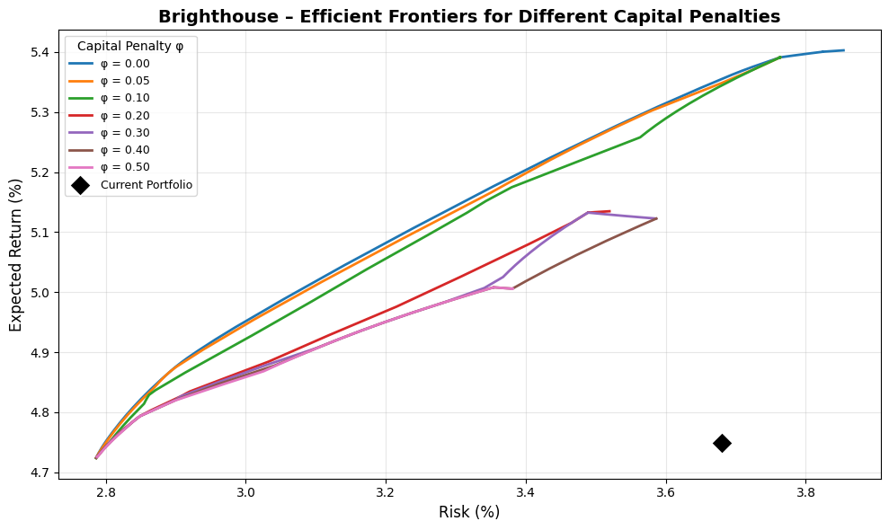
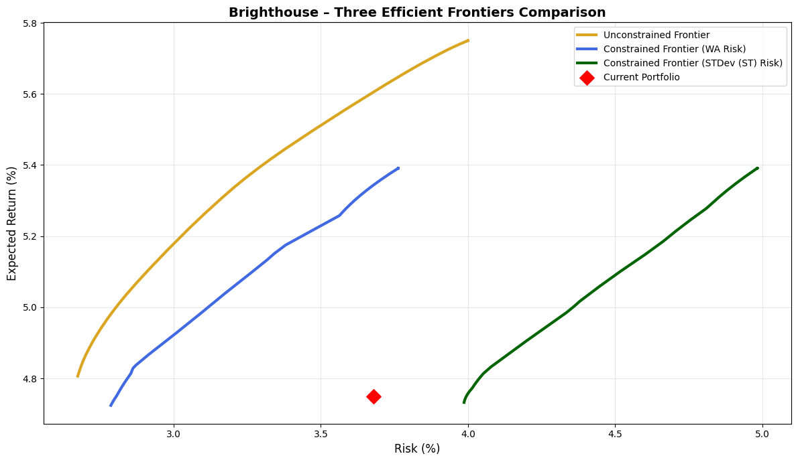
Impact of different capital penalties φ on the efficient frontier and unconstrained vs constrained efficient frontiers and
15

Slide 22
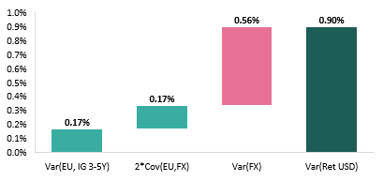
Cash and FX Risk Do Not Belong in Long-Term Strategic Allocation
Cash is excluded from return modeling due to its structural return deficiency, policy-driven volatility, and minimal long-term role in insurer portfolios; a fixed 1% allocation reflects its tactical liquidity function.
Foreign currency bonds are modeled using hedged indexes to strip out uncompensated FX volatility, aligning with institutional best practices that seek interest rate exposure, not currency noise.
Foreign currency volatility makes up the majority of the unhedged foreign currency bond risk
21

Slide 23
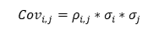
Covariance Matrix Built from Horizon-Matched Risks and Empirical Co-Movement
Risk inputs are custom volatility measures tailored to long-term economic exposures
Correlations are empirically estimated from excess returns of public proxies, then combined with custom σ via the covariance identity:
$${Cov}_{i,j}=ρ_{i,j}∗σ_{i}∗σ_{j}$$
US Treasuries, Short/Intermediate | 1.0 | 0.9 | 0.5 | 0.8 | 0.9 | 0.7 | 0.6 | 0.5 | 0.0 | 0.1 | 0.7 | 0.8 | 0.2 | 0.3 | 0.2 | 0.1 | -0.4 | 0.2 | 0.2 | 0.0 | 0.0
US Treasuries, Long | 0.9 | 1.0 | 0.6 | 0.8 | 0.9 | 0.8 | 0.6 | 0.5 | 0.0 | 0.1 | 0.7 | 0.8 | 0.2 | 0.3 | 0.2 | 0.2 | 0.3 | 0.2 | 0.2 | 0.0 | 0.0
US Taxable Munis | 0.5 | 0.6 | 1.0 | 0.7 | 0.7 | 0.7 | 0.7 | 0.7 | 0.5 | 0.5 | 0.6 | 0.7 | 0.4 | 0.6 | 0.3 | 0.3 | 0.2 | 0.5 | 0.4 | 0.0 | 0.0
Global ex-US Government, hedged | 0.8 | 0.8 | 0.7 | 1.0 | 0.8 | 0.8 | 0.7 | 0.6 | 0.2 | 0.3 | 1.0 | 0.8 | 0.3 | 0.3 | 0.3 | 0.2 | -0.1 | 0.4 | 0.3 | 0.0 | 0.0
US Public Corporates IG AAA | 0.9 | 0.9 | 0.7 | 0.8 | 1.0 | 0.9 | 0.7 | 0.6 | 0.2 | 0.3 | 0.6 | 0.9 | 0.4 | 0.4 | 0.3 | 0.2 | 0.4 | 0.5 | 0.4 | 0.0 | 0.0
US Public Corporates IG AA | 0.7 | 0.8 | 0.7 | 0.8 | 0.9 | 1.0 | 1.0 | 0.9 | 0.5 | 0.6 | 0.6 | 0.8 | 0.5 | 0.5 | 0.4 | 0.4 | 0.4 | 0.5 | 0.5 | 0.0 | 0.1
US Public Corporates IG A | 0.6 | 0.6 | 0.7 | 0.7 | 0.7 | 1.0 | 1.0 | 0.9 | 0.6 | 0.7 | 0.6 | 0.7 | 0.6 | 0.6 | 0.4 | 0.4 | 0.4 | 0.5 | 0.6 | 0.1 | 0.1
US Public Corporates IG BBB | 0.5 | 0.5 | 0.7 | 0.6 | 0.6 | 0.9 | 0.9 | 1.0 | 0.8 | 0.8 | 0.6 | 0.6 | 0.6 | 0.7 | 0.5 | 0.5 | 0.4 | 0.5 | 0.6 | 0.0 | 0.0
US Public Corporates, HY Intermediate | 0.0 | 0.0 | 0.5 | 0.2 | 0.2 | 0.5 | 0.6 | 0.8 | 1.0 | 0.9 | 0.2 | 0.3 | 0.7 | 0.6 | 0.5 | 0.5 | 0.8 | 0.5 | 0.7 | 0.0 | 0.1
US Public Corporates, HY Long | 0.1 | 0.1 | 0.5 | 0.3 | 0.3 | 0.6 | 0.7 | 0.8 | 0.9 | 1.0 | 0.2 | 0.4 | 0.7 | 0.6 | 0.5 | 0.5 | 0.8 | 0.5 | 0.7 | 0.0 | 0.1
Global ex-US Corporates, hedged | 0.7 | 0.7 | 0.6 | 1.0 | 0.6 | 0.6 | 0.6 | 0.6 | 0.2 | 0.2 | 1.0 | 0.7 | 0.7 | 0.7 | -0.1 | -0.1 | -0.1 | 0.4 | 0.4 | -0.2 | -0.2
Residential Mortgage-Backed Securities | 0.8 | 0.8 | 0.7 | 0.8 | 0.9 | 0.8 | 0.7 | 0.6 | 0.3 | 0.4 | 0.7 | 1.0 | 0.3 | 0.4 | 0.2 | 0.2 | 0.0 | 0.5 | 0.3 | 0.0 | 0.0
Commercial Mortgage-Backed Securities | 0.2 | 0.2 | 0.4 | 0.3 | 0.4 | 0.5 | 0.6 | 0.6 | 0.7 | 0.7 | 0.7 | 0.3 | 1.0 | 0.4 | 0.5 | 0.4 | 0.0 | 0.5 | 1.0 | 0.0 | 0.2
Asset-Backed Securities | 0.3 | 0.3 | 0.6 | 0.3 | 0.4 | 0.5 | 0.6 | 0.7 | 0.6 | 0.6 | 0.7 | 0.4 | 0.4 | 1.0 | 0.5 | 0.4 | 0.0 | 0.5 | 0.5 | 0.0 | 0.1
Corporate IG Private Placement A | 0.2 | 0.2 | 0.3 | 0.3 | 0.3 | 0.4 | 0.4 | 0.5 | 0.5 | 0.5 | -0.1 | 0.2 | 0.5 | 0.5 | 1.0 | 1.0 | 0.7 | 0.5 | 0.5 | 0.2 | 0.2
Corporate IG Private Placement BBB | 0.1 | 0.2 | 0.3 | 0.2 | 0.2 | 0.4 | 0.4 | 0.5 | 0.5 | 0.5 | -0.1 | 0.2 | 0.4 | 0.4 | 1.0 | 1.0 | 0.7 | 0.5 | 0.4 | 0.1 | 0.2
Corporate HY Private | -0.4 | 0.3 | 0.2 | -0.1 | 0.4 | 0.4 | 0.4 | 0.4 | 0.8 | 0.8 | -0.1 | 0.0 | 0.0 | 0.0 | 0.7 | 0.7 | 1.0 | 0.4 | 0.4 | 0.7 | 0.4
Residential Mortgage Whole Loans | 0.2 | 0.2 | 0.5 | 0.4 | 0.5 | 0.5 | 0.5 | 0.5 | 0.5 | 0.5 | 0.4 | 0.5 | 0.5 | 0.5 | 0.5 | 0.5 | 0.4 | 1.0 | 1.0 | 0.4 | 0.3
Commercial Mortgage Whole Loans | 0.2 | 0.2 | 0.4 | 0.3 | 0.4 | 0.5 | 0.6 | 0.6 | 0.7 | 0.7 | 0.4 | 0.3 | 1.0 | 0.5 | 0.5 | 0.4 | 0.4 | 1.0 | 1.0 | 0.0 | 0.2
Private Equity | 0.0 | 0.0 | 0.0 | 0.0 | 0.0 | 0.0 | 0.1 | 0.0 | 0.0 | 0.0 | -0.2 | 0.0 | 0.0 | 0.0 | 0.2 | 0.1 | 0.7 | 0.4 | 0.0 | 1.0 | 0.7
Real Estate (via partnerships, equity) | 0.0 | 0.0 | 0.0 | 0.0 | 0.0 | 0.1 | 0.1 | 0.0 | 0.1 | 0.1 | -0.2 | 0.0 | 0.2 | 0.1 | 0.2 | 0.2 | 0.4 | 0.3 | 0.2 | 0.7 | 1.0
22

Slide 24
Equity Returns Anchored in Shareholder Cash Flows, Not Earnings Noise
Public equity expected returns are built bottom-up using sector-level dividend and buyback yields, not accounting-based metrics.
Cash yield measures are more robust than earnings, as they are harder to manipulate and directly reflect shareholder payouts.
Buybacks now rival dividends in size and are essential to capturing the true return potential of U.S. large-cap equities.
Buyback yields have considerably increased since 2012
23

Slide 25
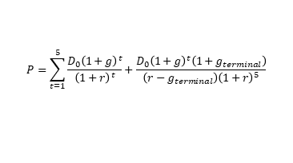
Valuation and Structural Signals Refine Equity Return Expectations
Implied equity risk premia (ERP) are derived via a two-stage DDM, solving for cost of equity at the sector level.
This multi-layer approach ensures forward-looking return estimates reflect real sector dynamics.
$$P=\sum_{t=1}^{5}{\frac{D_{0}{\left(1+g\right)}^{t}}{{\left(1+r\right)}^{t}}+\frac{D_{0}{\left(1+g\right)}^{t}\left(1+g_{terminal}\right)}{\left(r−g_{terminal}\right){\left(1+r\right)}^{5}}}$$
Implied ERP levels have been more volatile in the last decade
24

Slide 26
Valuation & Margin Trends Refine Cash-Based Equity Return Forecasts
Implied equity risk premia (ERP) are refined using sector-specific CAPE regressions and long-term profitability trends to capture valuation mispricing and structural shifts.
Only sectors with strong CAPE-return relationships (R² > 0.2) received valuation adjustments; profitability trends were layered on top for sectors with meaningful structural margin shifts.
The relationship between CAPE signal and excess return has shifted but maintained strong negative relationship for Information Technology with twice as high R-squared. Blue dots represent time period 2009-2015, red dots are for 2015-2020, while black line represents the full sample.
The full explanation of the methodology can be found in the paper version of this report.
25

